Slide 1
TEST 1
TEST 2
TEST 2
f_{tonic} [Hz]
5x
1
high
2
1
interm
…
low
100
corr. tonic
95x
strong
weak
Param set A with 10% var
Param set A with 10% var
Param set B with 10% var
Gamma_d *0.7
Gamma_d
Gamma_d

Slide 2
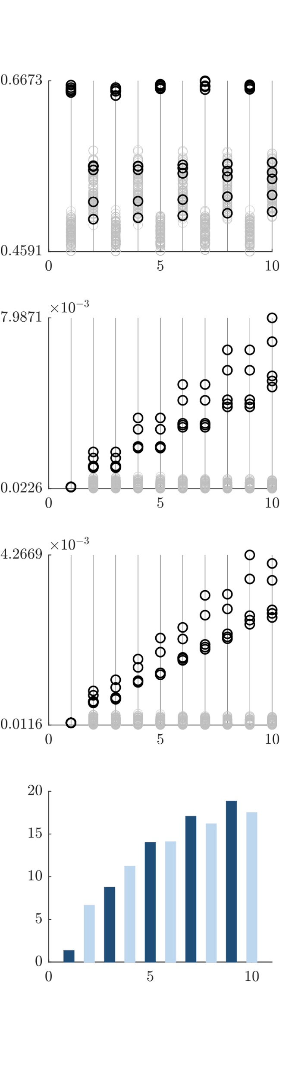

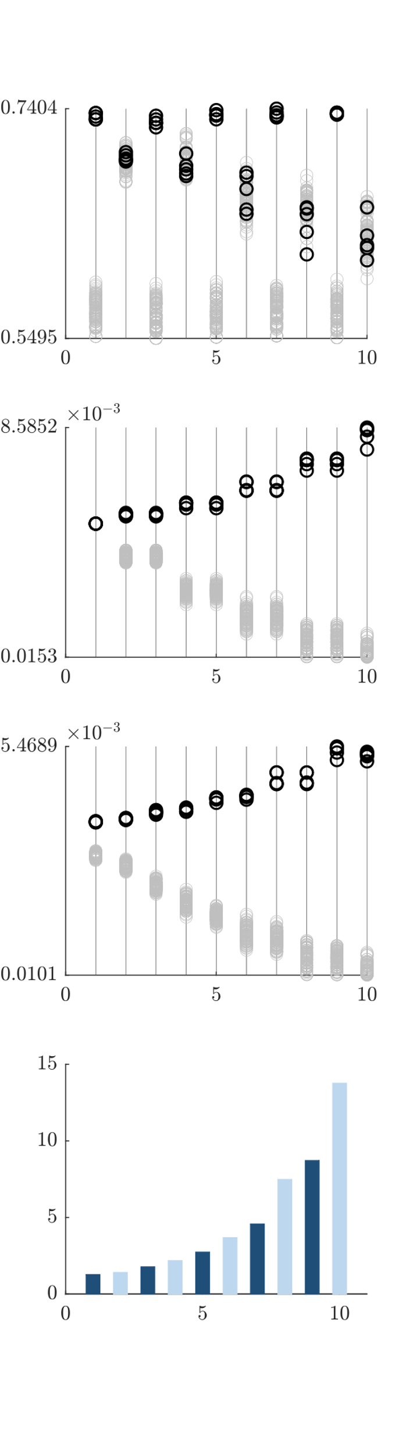
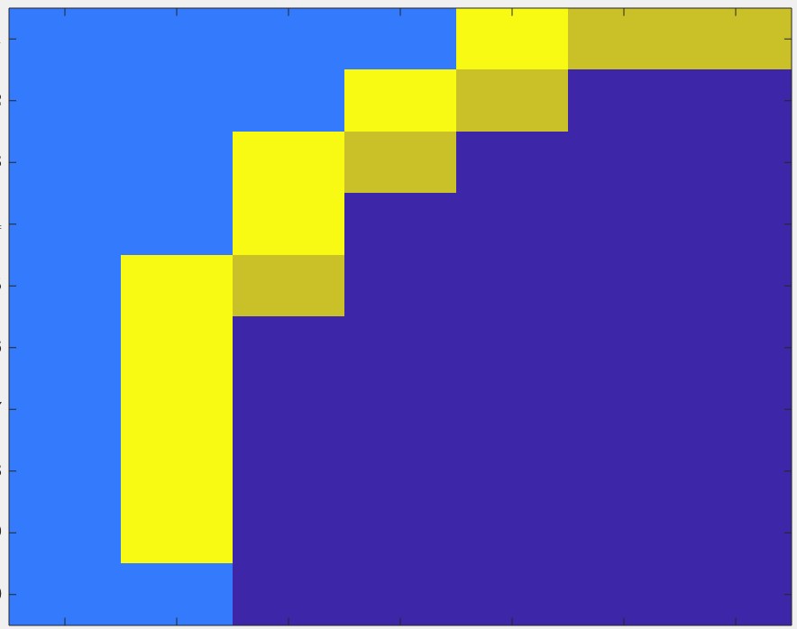
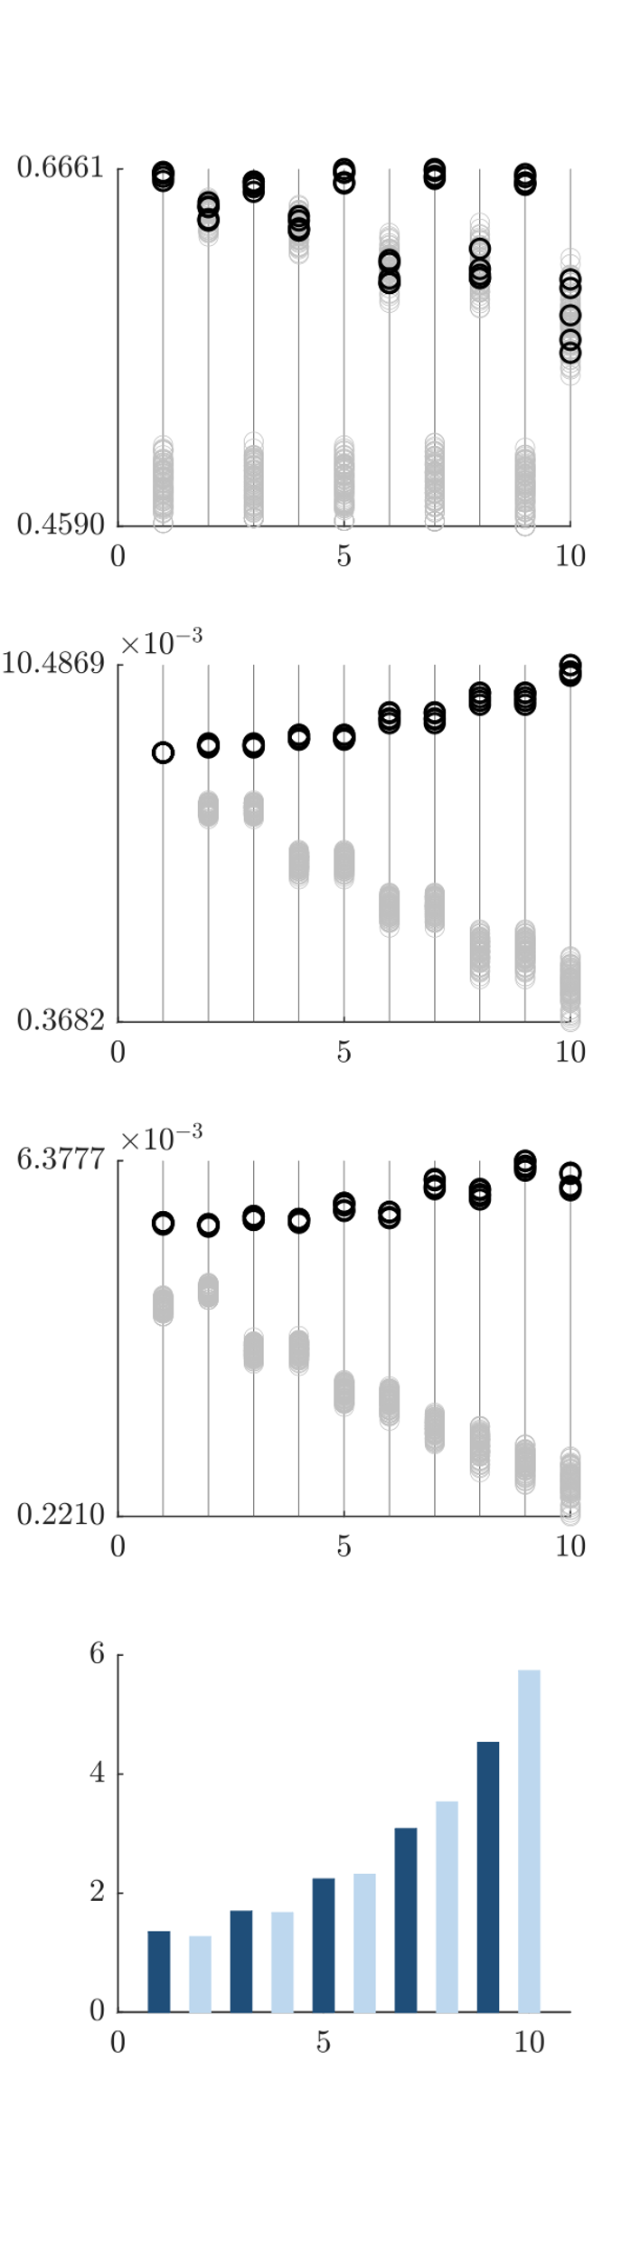
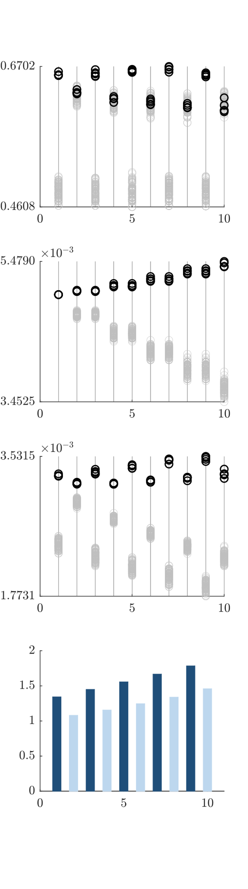
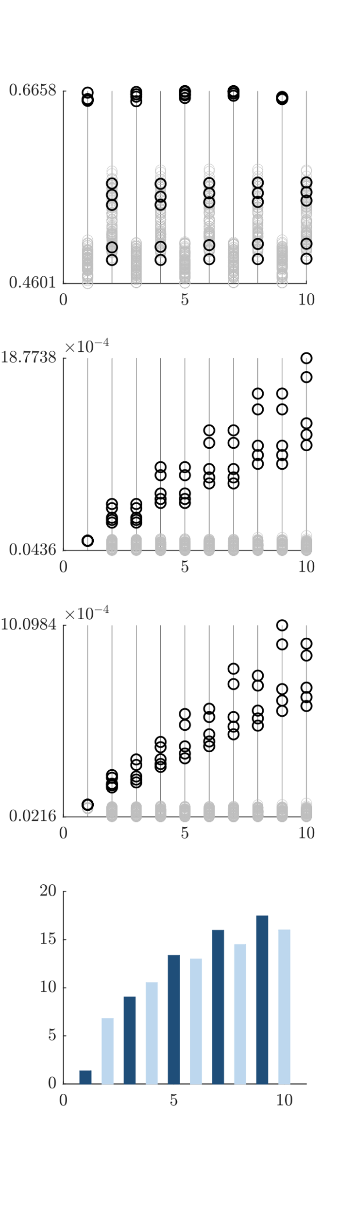
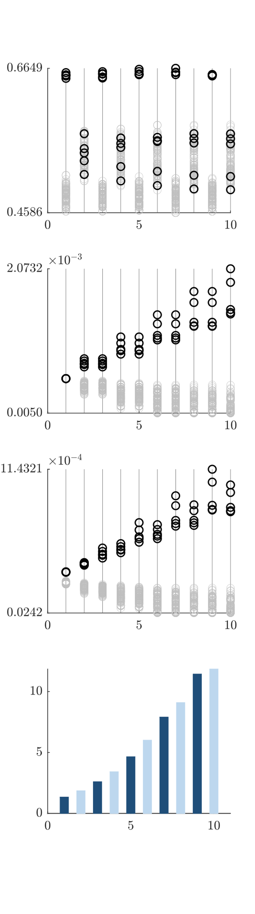
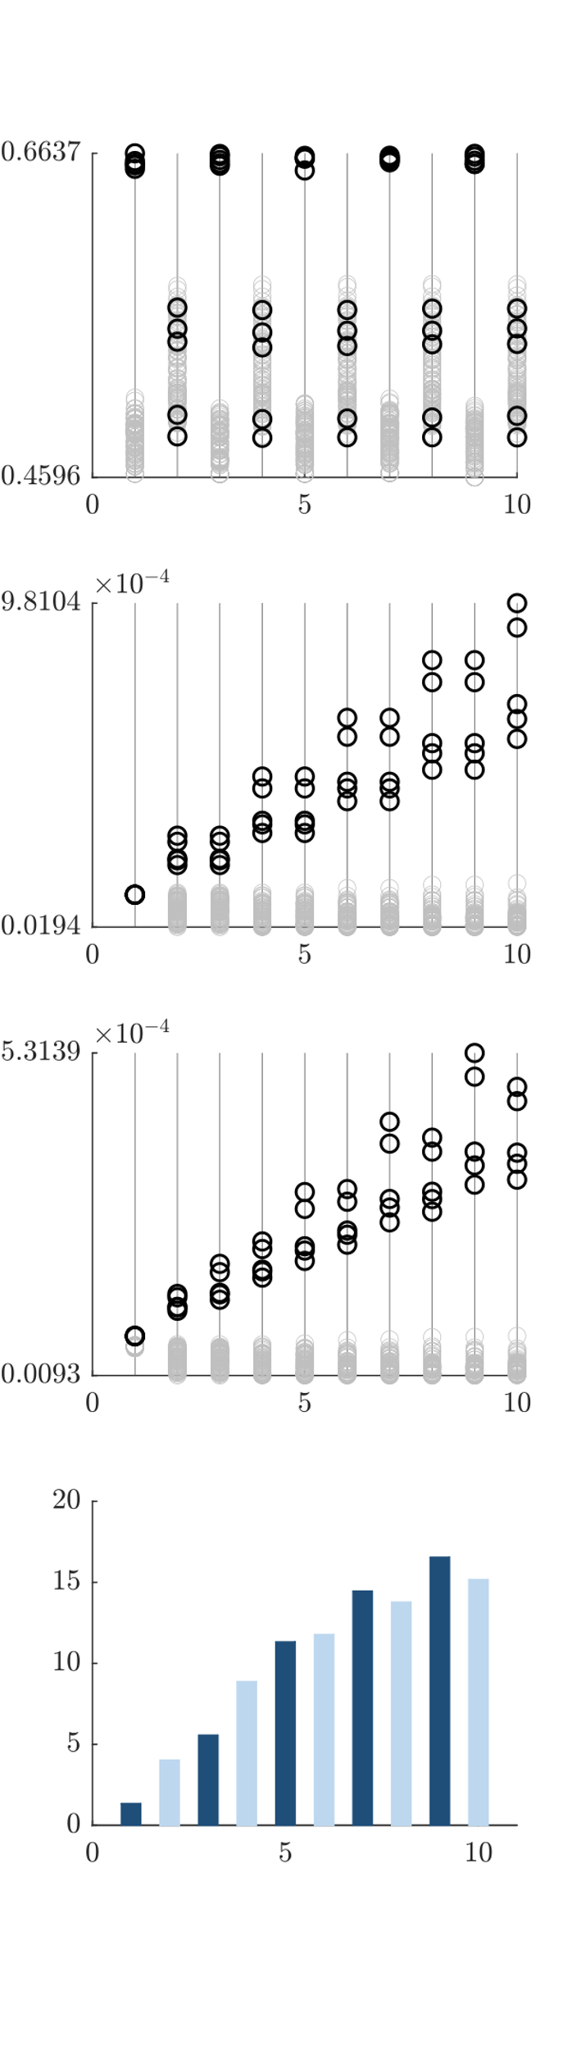
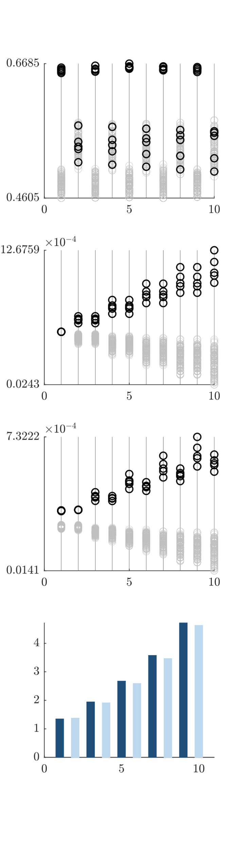
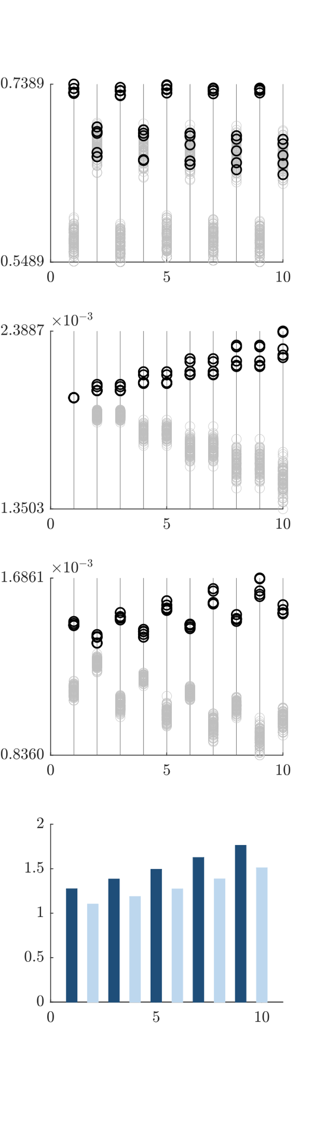
A
B
WEAK initial
late-weight
C
STRONG initial
late-weight
STRONG
Prop. factor
l0
0.0001
0.0005
0.001
0.002
0.005
0.008
0.01
Tau_l
C*
100
A
B
C
C*
200
300
F
D
E
400
500
D
E
F
600
700
800
900
I
G
H
G
H
1000
I
WEAK
Prop. factor
Up-selection
Up- to
downselection
Down-
To up selection
Down-selection

Slide 3

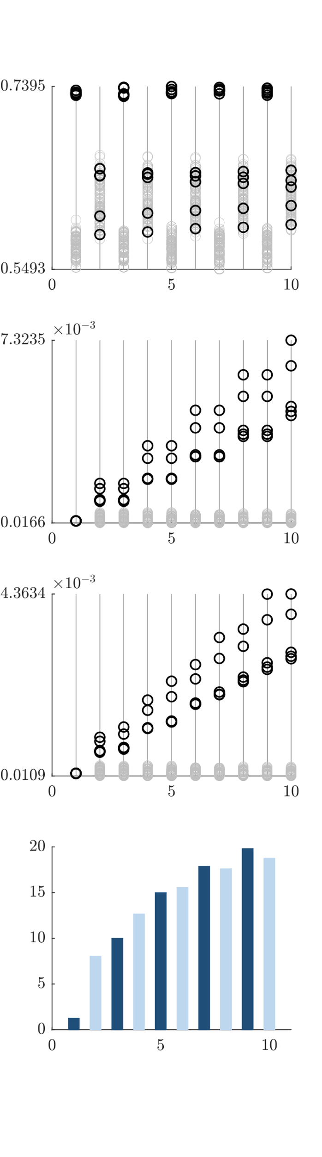
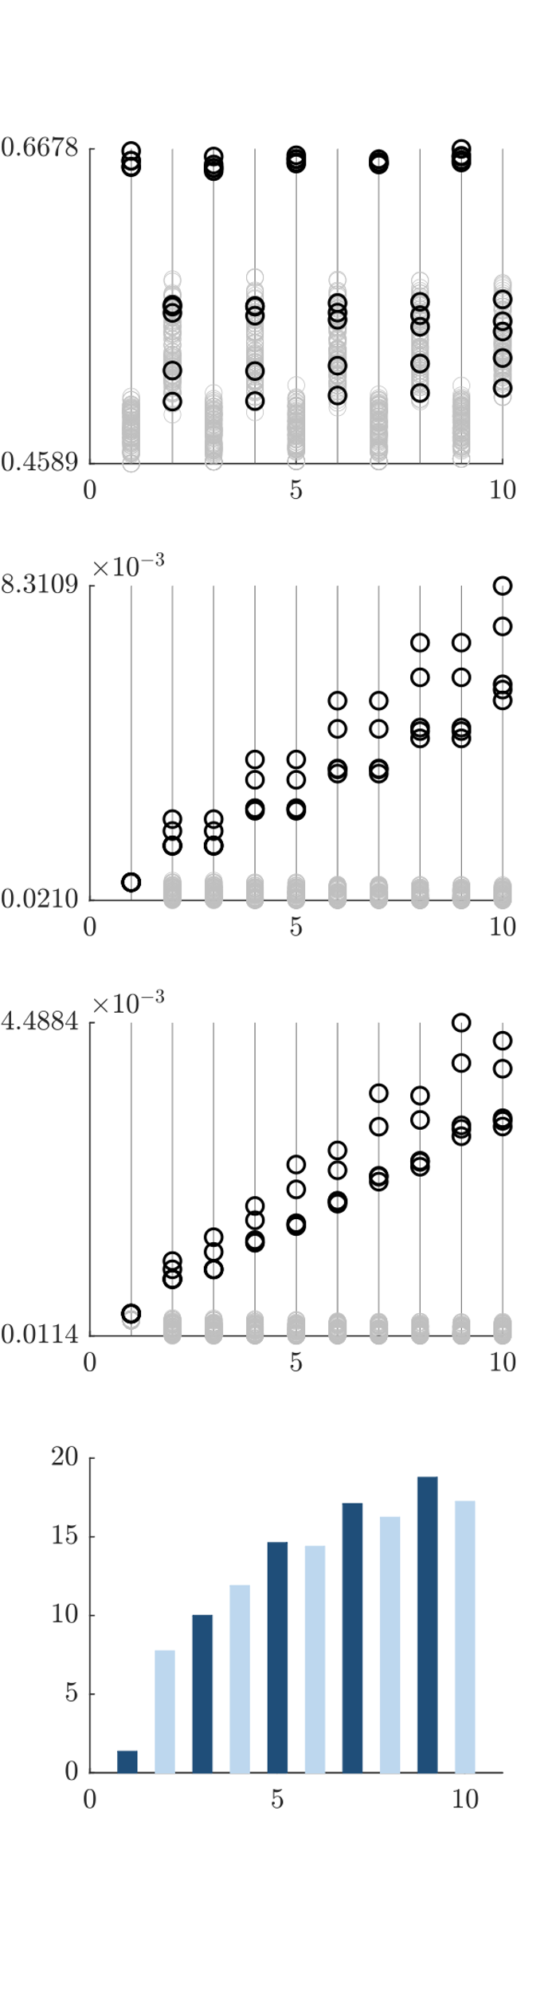
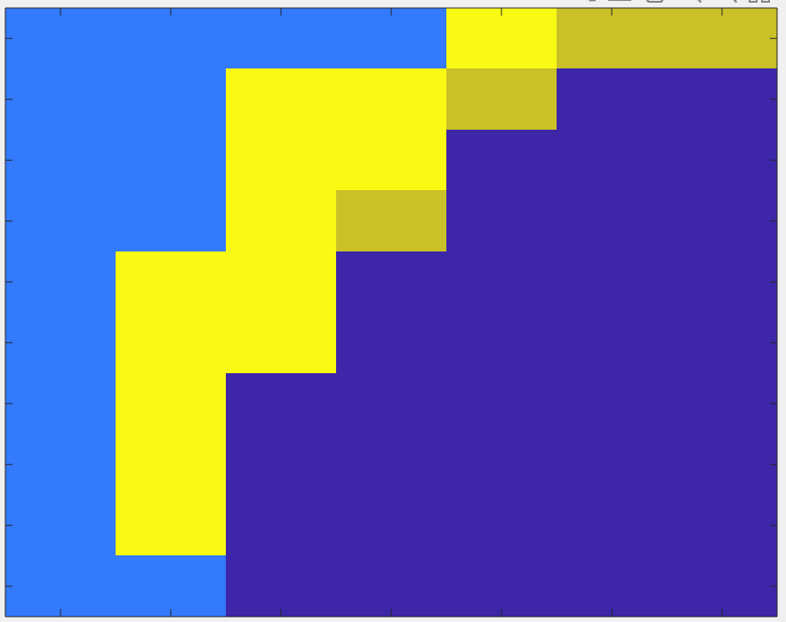
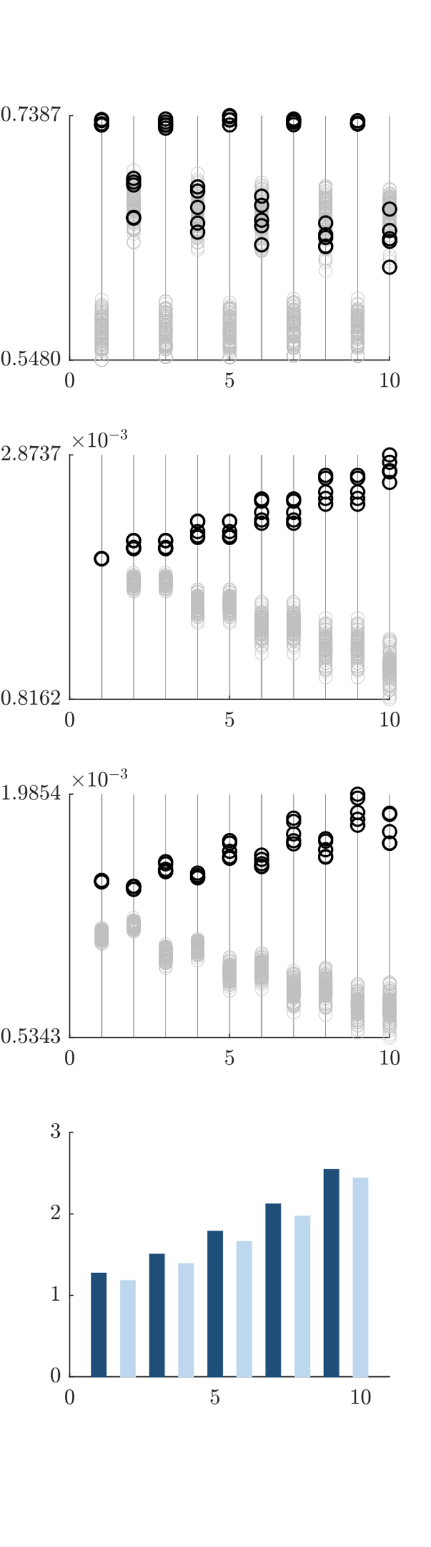
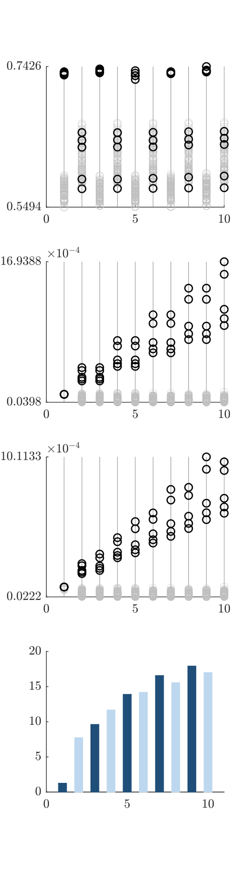

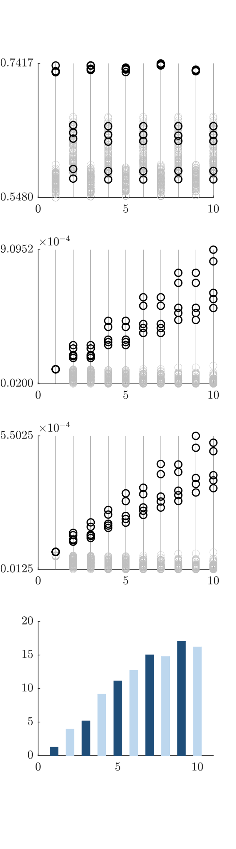

A
B
WEAK initial
late-weight
C
STRONG initial
late-weight
STRONG
Prop. factor
l0
0.0001
0.0005
0.001
0.002
0.005
0.008
0.01
Tau_l
100
C
A
B
200
300
F
D
E
400
500
D
E
F
600
700
800
900
I
G
H
1000
G
H
I
WEAK
Prop. factor
Up-selection
Up- to
downselection
Down-
To up selection
Down-selection

Slide 4
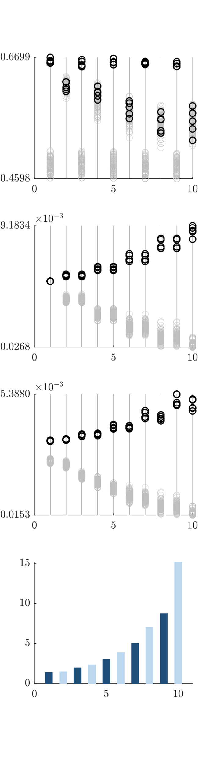

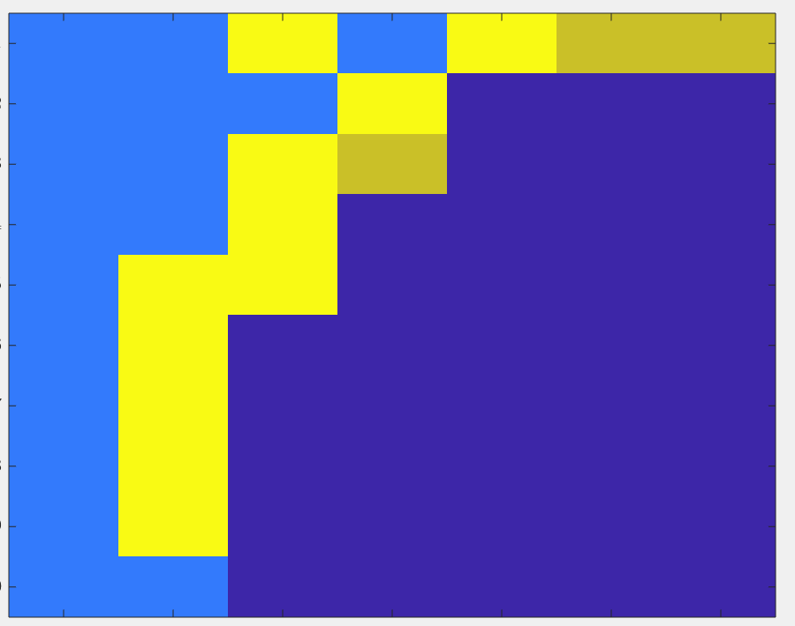
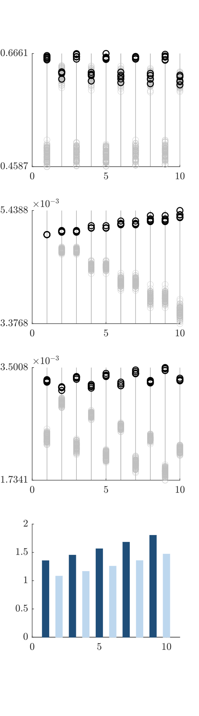
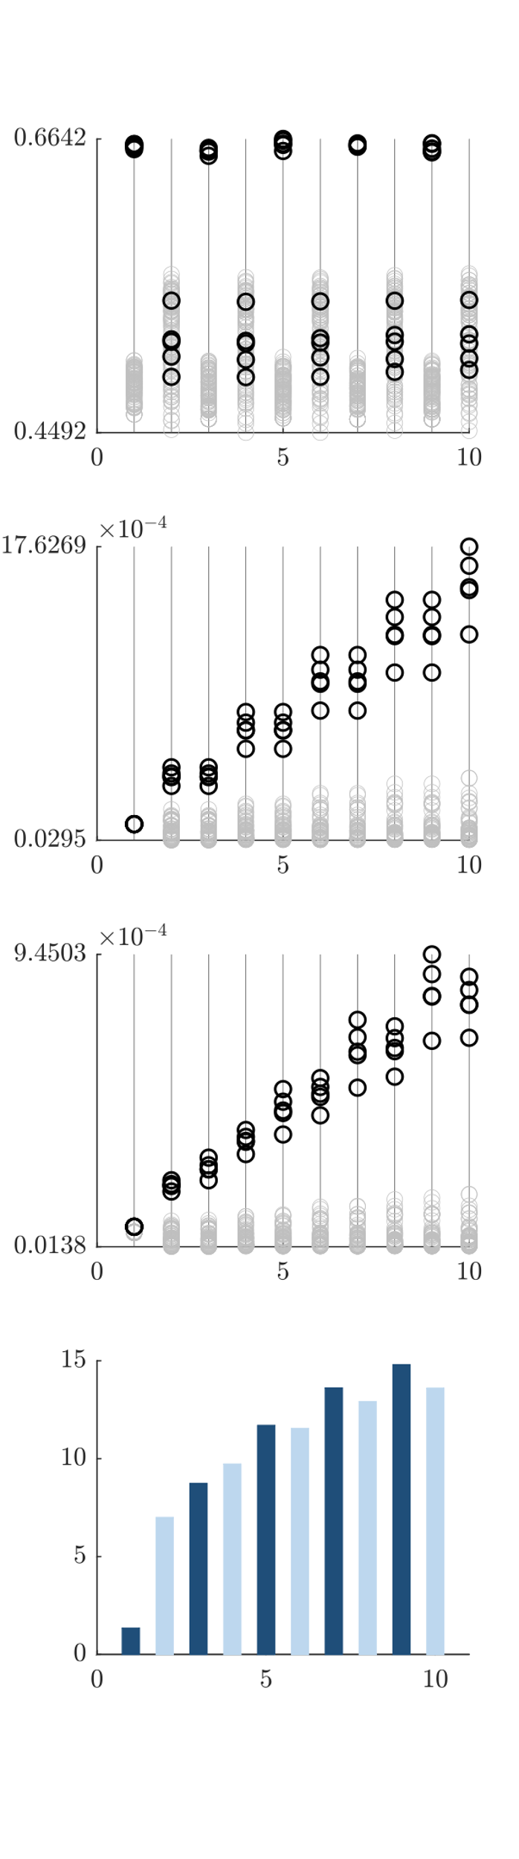
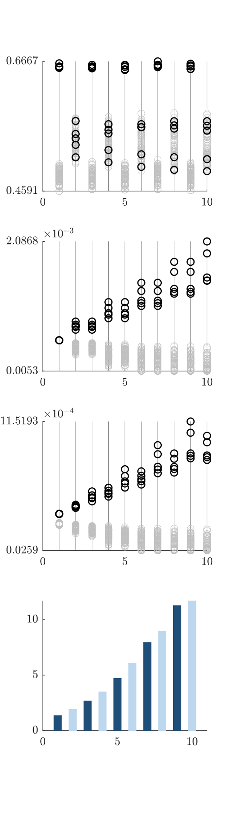
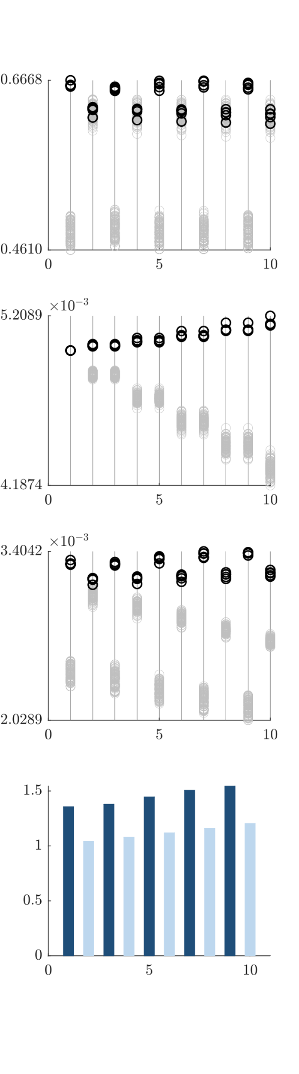


C
A
B
WEAK initial
late-weight
STRONG initial
late-weight
STRONG
Prop. factor
l0
0.0001
0.0005
0.001
0.002
0.005
0.008
0.01
Tau_l
100
A
B
200
300
F
D
E
400
500
D
E
F
600
700
800
900
I
G
H
G
H
1000
I
WEAK
Prop. factor
Up-selection
Up- to
downselection
Down-
To up selection
Down-selection

